Slide 1


K I T
keep it together
February 10, 2022
Team 25

Slide 2
The Team
Database
Rebecca
API
Kyle & Marcus
Front End
Alex & Gabriella
Project Manager
Alex

Slide 3

Technology
Database
MySql, puTTY
API
SwaggerHub, ARC, DigitalOcean, Putty
Front End
BootStrap, Framer
Management
Discord, Trello, Smartsheet

Slide 4
Success
Struggles
Good team dynamics
Good usage of discord
Consistent twice weekly meetings
Implementing front end mock ups
Had domain issues that were out of our control
Had to rebuild the database

Slide 5
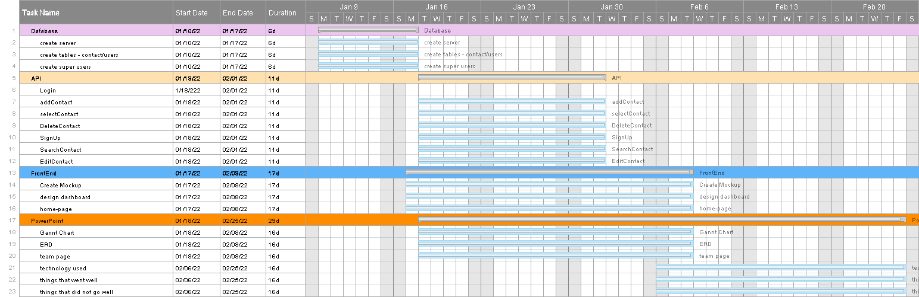
Gantt Chart

Slide 6


Use Case Diagram
Username Taken
Add Contact
<<extends>>
Sign Up
Search Contact
New User
Select Contact
Login
server
<<includes>>
<<includes>>
Edit Contact
Delete Contact
Returning User
<<extends>>
Bad Login

Slide 7
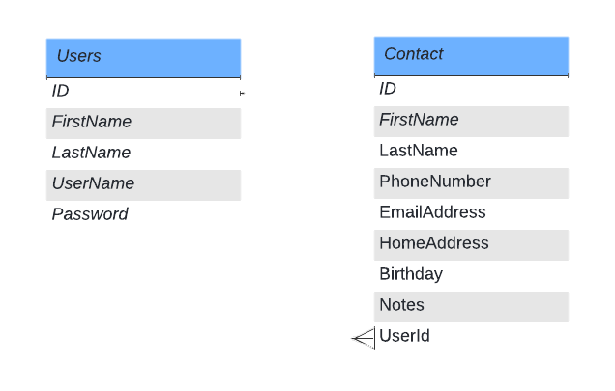
Entity Relationship Diagram

Slide 8
API Demonstration
SwaggerHub

Slide 9

Website Demonstration
Kit

Slide 10
Questions?
Thank you for watching!

